Slide 1
Network Intrusion Detection System
MINOR PROJECT
By:
ARJUN KUMAR 2K14/SE/020
DEWESH DEO SINGH 2K14/SE/026
HIMANSHU MITTAL 2K14/SE/036
MANPREET SINGH 2K14/SE/045

Slide 2
Problem statement
To develop a network intrusion detection system using machine learning algorithms, which can be deployed in a Real time environment.
It should be able to predict the type of the network connection i.e. either as normal or anomalous.

Slide 3
Approach

Slide 4
ML Techniques used
Naïve Bayes
Decision Tree

Slide 5
Naïve Bayes
Why..?
It is easy and fast to predict class of test data set. It also perform well in multi class prediction
When assumption of independence holds, a Naive Bayes classifier performs better compare to other models like logistic regression and you need less training data.
It perform well in case of categorical input variables compared to numerical variable(s). For numerical variable, normal distribution is assumed (bell curve, which is a strong assumption).

Slide 6
Decision Tree
Why..?
Are simple to understand and interpret. People are able to understand decision tree models after a brief explanation.
Have value even with little hard data. Important insights can be generated based on experts describing a situation (its alternatives, probabilities, and costs) and their preferences for outcomes.
Allow the addition of new possible scenarios
Help determine worst, best and expected values for different scenarios
Use a white box model. If a given result is provided by a model.
Can be combined with other decision techniques

Slide 7
Tools used
WEKA (For applying ML algorithms)
R (For model visualization)
JAVA (For implementation)

Slide 8
RESULTS
Decision Tree
total_instances : 22544
total_anamoly : 12833
correct pred :17913
incorrect predictions : 4631
precision96.0
recall : 65.0
accuracy : 79.0

Slide 9
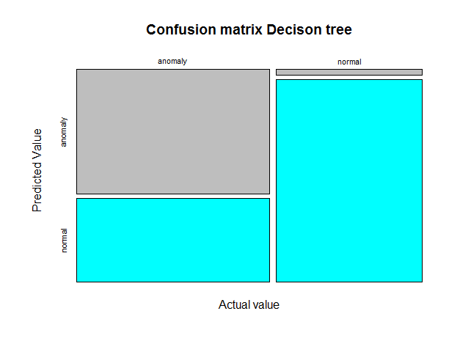

Slide 10
RESULTS
Naïve Bayes
total_instances : 22544
total_anamoly : 12833
correct pred :17160
incorrect predictions : 5384
precision92.0
recall : 63.0
accuracy : 76.0

Slide 11
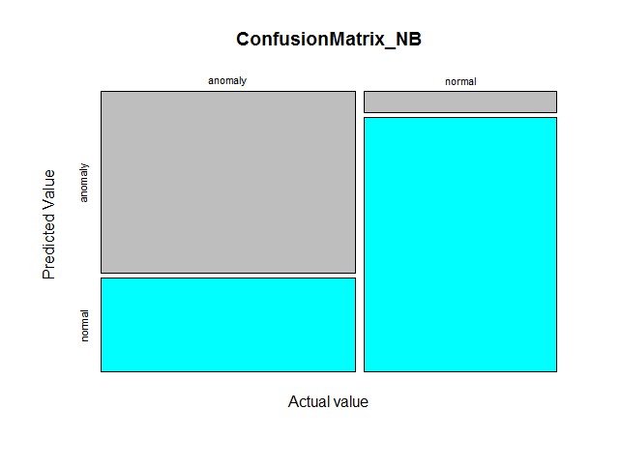

Slide 12
RESULTS
Combined
total_instances : 22544
total_anamoly : 12833
correct pred :18543
incorrect predictions : 4001
precision92.0
recall : 74.0
accuracy : 82.0

Slide 13
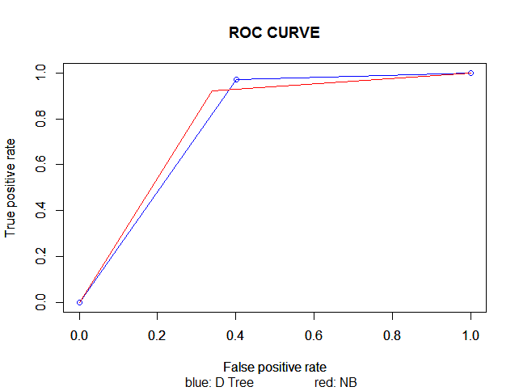

Slide 14
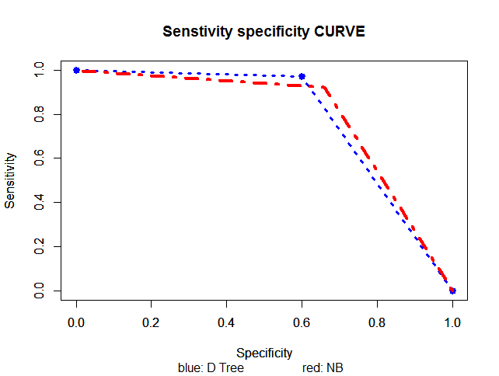

Slide 15
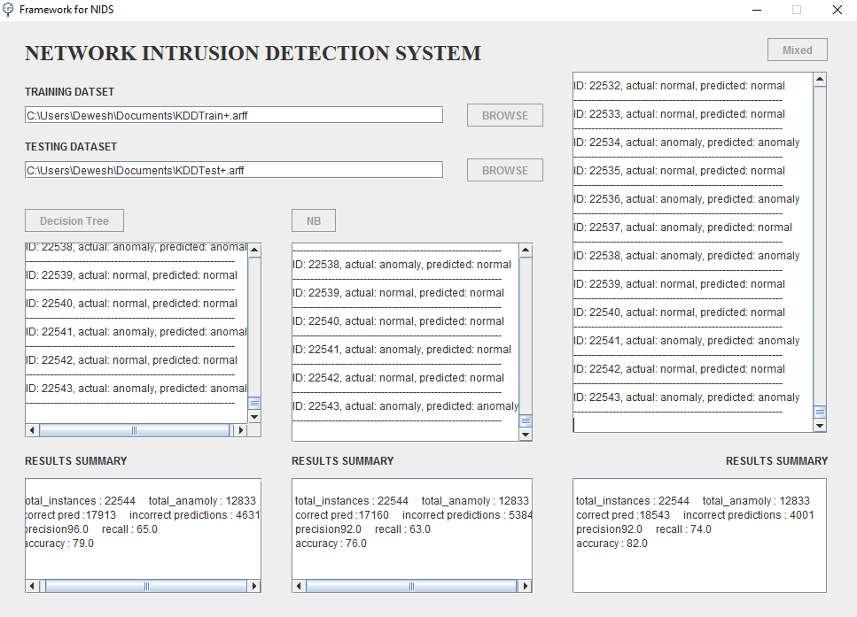
System snapshot

Slide 16
THANK YOU...!!!

